Slide 1



MASTERING YOUR PENSION JOURNEY (SECURING YOUR FUTURE TODAY)
A better tomorrow

Slide 2

Presentation Outline
Introduction
Categories of Retirement Capitals
Health Capital
Social Capital
Financial Capital
Conclusion
www.peoplespensiontrust.com

Slide 3

Introduction
Retirement planning is process of setting goals for retirement years and, actions and decisions needed for achieving those goals
People mostly look at just the financial goals
However, inasmuch as financial capital is very important for retirement, there are other equally important capitals that needs to be addressed.
"... effective planning takes you more than halfway to effective execution"
www.peoplespensiontrust.com

Slide 4
Categories of Retirement Capital
"Controlling your direction is better than being controlled by it."
~ Jack Welch
Retirement Capital
Financial Capital
Health Capital
Social Capital
www.peoplespensiontrust.com

Slide 5
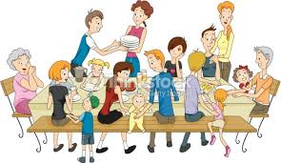
Social Capital
Social capital is generated when you invest in your relationships, by being as valuable as you possibly can be in your network.
www.peoplespensiontrust.com

Slide 6
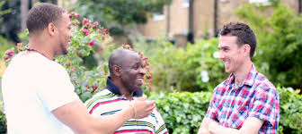
Social Capital (Cont’d)
This means, being seen as an invaluable resource.
In short, social capital measures the degree of influence which we have through our networks. It’s crucial to your success in business, and to the sense of meaning in your life.
www.peoplespensiontrust.com

Slide 7
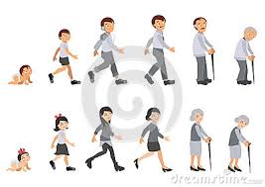
Health Capital
The World Health Organisation (WHO) defines health as ‘a state of complete physical, mental and social wellbeing and not merely the absence of disease or infirmity’
(WHO, 1948)
www.peoplespensiontrust.com

Slide 8
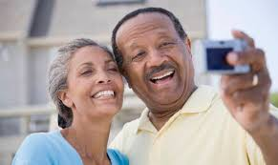
Health Capital (Cont’d)
A sound mind in a sound body … By Greek Philosopher Thales
Health capital is all about your physical and mental investment made to age gracefully.
In our early ages our lifestyles will definitely show in our old age.
www.peoplespensiontrust.com

Slide 9

Financial Capital
Financial Capital is not only about money but also being “money smart” (financial acumen).
www.peoplespensiontrust.com

Slide 10
Financial Capital (Cont’d)
Financial Capital for retirement can be generated from the following sources;
Under National Pension Act (Act 766)
Savings & Investments
Assets (Buildings, Land etc)
www.peoplespensiontrust.com

Slide 11
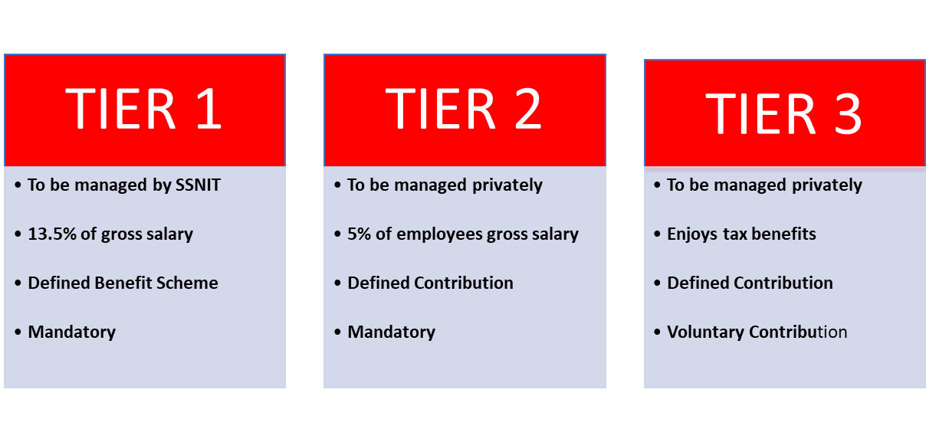
Financial Capital (Cont’d)
Under National Pension Act (Act 766)
www.peoplespensiontrust.com

Slide 12
Financial Capital (Cont’d)
Develop Savings Strategy
Find money for savings and investment;
For example, target for at least 10% of your current income, increase the amount as you become comfortable with the loss of spending capital
Look for ways to save on everyday expenses
Build wealth not debt
Assets (Buildings, Land etc)
Ensure your assets are easily converted to liquid (cash)
www.peoplespensiontrust.com

Slide 13
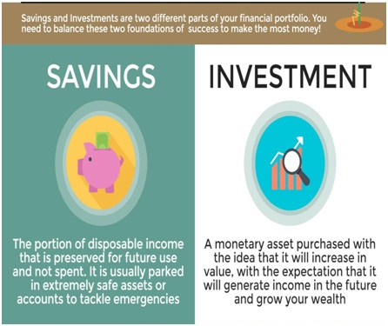
Financial Capital (cont’d)
Private Savings and Investments
While you should not rely on any of the above (1 , 2 & 3) alone, taken together all of them can make you financially comfortable

Slide 14
Conclusion
Start planning early and ask yourself how and where you want to retire
Plan for the possibility of living longer than you now expect
Create a financial plan
Pay of major debt e.g. Mortgages and other cash flow drains quickly
Look out for other things that brings you joy outside your profession or job.
Build a good network around family and friends
www.peoplespensiontrust.com

Slide 15
CONTACT US
Loc:
No.5 Sam Nujoma Close, North Ridge Adjacent the
Visa Section of the German Embassy
Accra-Ghana.
Tel:
+233 302 738 242
Website:
www.peoplespensiontrust.global
Email:
info@peoplespensiontrust.com
www.peoplespensiontrust.com

